Slide 1



Manage your environment
– the secure way

Slide 2




GET-EXPERTS
Mikael Nystrom
Hasain Alshakarti
@mikael_nystrom
@Alshakarti
Mikael.nystrom@truesec.com
Hasain.Alshakarti@truesec.com
MVP – 15 Years
The “Wolf”
Likes Food, mostly
Halal
Notes:
MN ML

Slide 3


Slide 4
The organization that existed until it didn’t
NTLM Authentication
If everyone’s a local admin then no one’s a local admin!
Technically correct
Password resets what are those?
Azure AD and MFA What’s that?
Patch Management

Slide 5
Could it been prevented?
10 year old guidelines on how to manage IT would have prevented it

Slide 6
Numbers
45 Minutes
The time it takes for our pen testers to be administrators
80 %
Number of successful attacks done be steeling admin credentials
6 Months
The time between first penetration until detection

Slide 7
Could it been prevented?
10 year old guidelines on how to manage IT would have prevented it

Slide 8
DEMO SLIDE
Let us do some fun stuff…
Notes:
MN

Slide 9
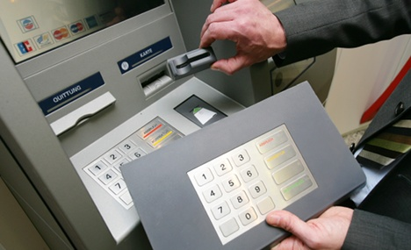

Slide 10
Attack services are inexpensive
Ransomware:
$66 upfront
Or
30% of the profit (affiliate model)
0days price range varies from $5,000 to $350,000
ATTACKS AGAINST THE PC
ATTACKS AGAINST THE EMPLOYEES AND CUSTOMERS
Loads (compromised device) average price ranges
PC - $0.13 to $0.89
Mobile - from $0.82 to $2.78
Spearphishing services range from $100 to $1,000 per successful account take over
Denial of Service (DOS) average prices
day: $102.05
week: $327.00
month: $766.67
Compromised accounts As low as $150 for 400M. Averages $0.97 per 1k.
SERVICES AIDING THE “CASH OUT”
Proxy services to evade IP geolocation prices vary
As low as $100 per week for 100,000 proxies.
ATTACKER
INFRASTRUCTURE
COLLECTIVE KNOWLEDGE

Slide 11


Slide 12
Attackers Mindset
Identify High Value Targets
Fabric components, Domain controllers, Management Servers, jump servers, admin clients ...
Identify Privileged Accounts
Who are the administrators on these servers
Gain Access to Admin Credentials
What can be compromised to get the credentials of a target admin

Slide 13













Privileged Access is more than Administrators
USER
Identity Admins
*****
Cloud Service Admins
Security & Management Tool Admins
10-K
Critical Business Data/Systems
Privilege Accounts
High Impact Social Media Accounts

Slide 14
ROLES
USERS
DEVELOPERS
IT OPERATIONS / ADMINS
Enhanced Security Workstation
Low Security Plus…
Secured Workstation –aka PAW
High Security Plus…
Specialized Workstation
High Security Plus…
High Security Workstation
Enhanced Security Plus…
Low Security Workstation
Productivity Apps
Application and browser activity monitored
User Managed policies
Antivirus
Centrally Managed Policies
Defender ATP
No Local Admin
Restricted applications
Restricted browsing
No productivity applications
Restricted browsing
Separate identity
PROFILES
SECURITY CONTROLS
Secure Workstation Documentation
Overview- http://aka.ms/SWoverview
Implementation - http://aka.ms/secureworkstation
OR
Virtualization
Physical Separation

Slide 15
DEMO SLIDE
PAWs, Silo, SSO, Remote Admin
Notes:
MN

Slide 16
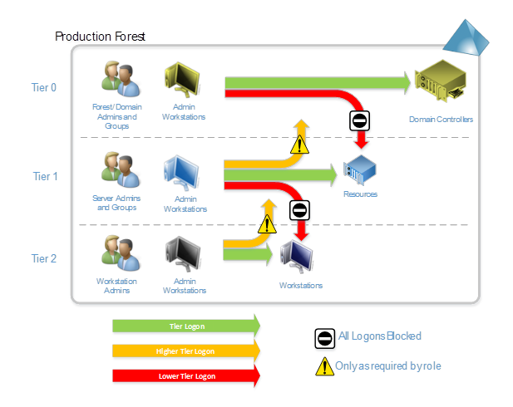

Slide 17
Private Cloud (Hyper-Converged)
Tenant A
Tenant B
Tenant C
WORKLOAD
Software Defined Storage & Compute
Software Defined Network
Management Stack
FABRIC
Storage
FW
Network Controller
Network Controller
SC SM
MGMT
SC DPM
Network
AD CA
MS SQL
ADFS
WAPR
AD DIRS
WSUS
SC OR SPF
AZ Admin
RDGW
Hyper-V
Hyper-V
Hyper-V
Hyper-V
Hyper-V
IPAM
DEPL
SC VMM
AZ Tenat
AZ GW
AD DS
SC OM
Hyper-V
Hyper-V

Slide 18
Server Management
Remote server support
Primary (tool) - Remote tools using network logons (PS Remoting, RPC, WMI)
Primary (interactive) - Logon using a local account password set by LAPS
Secondary (interactive) RDP (RemoteGuard / RestrictedAdmin) from PAW
Forbidden - Standard RDP with domain account
Forbidden - Using domain accounts while in the session
“Physical” server support
Primary - Log on using a local account password set by LAPS
Forbidden - Logon with a domain account
Forbidden - Using domain accounts while in the session

Slide 19
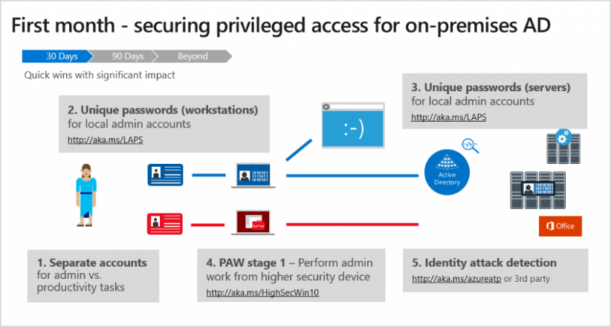
https://www.microsoft.com/security/blog/2018/11/29/secure-your-privileged-administrative-accounts-with-a-phased-roadmap/

Slide 20
“Attackers” target virtual machines
Compromised or malicious fabric admin can access guest VM’s
Health of hosts not taken into account before starting VMs
Tenant VMs are exposed to storage and network attacks
Virtual machines can’t take advantage of hardware-based security such as Trusted Platform Modules (TPMs)
Host OS
Guest VM 1
Guest VM 2
VM owner
Storage
Healthy host?
Hypervisor
Hypervisor
Fabric
Fabric

Slide 21
“Attackers” target privileged accounts
Hosts that are expected to use high-value accounts:
Computers used for administration
Computers used for support, such as help desk
System management servers
Admin Host
High Value Target 1
HVT 2
Hypervisor
Fabric

Slide 22
DEMO SLIDE
Host Guardian Services and Shielded VM’s
Notes:
MN

Slide 23
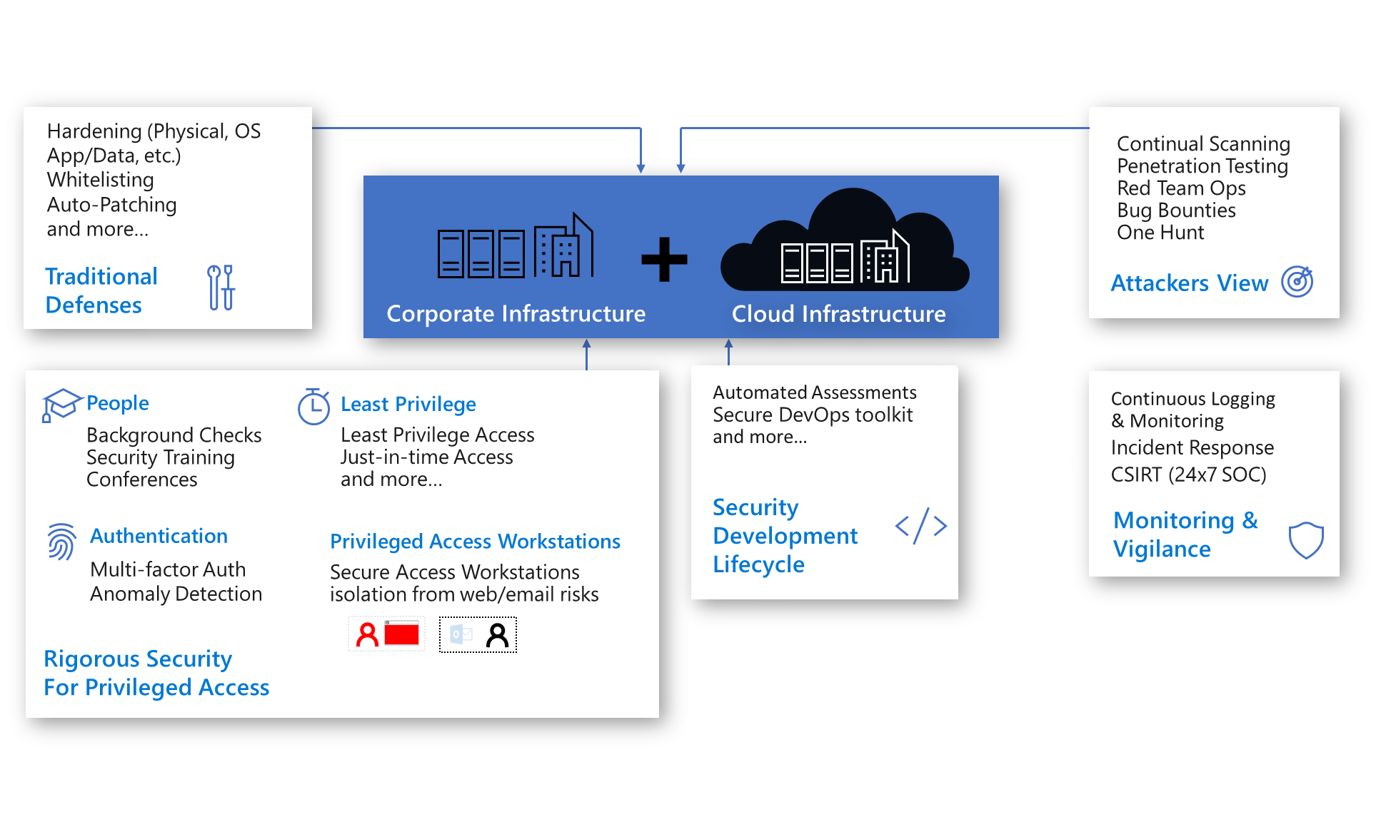

Slide 24
Transforming from Legacy to Cloud
Risk
Patching
Sandboxing
Scanning
Segmentation
Encryption
Secure Development Lifecycle
Forensics
Threat Protection
Logging & Analytics
Orchestration & Automation
SIEM
Architectures change, but principles & outcomes remain the same
WAFs
Vulnerability Management
Firewalls
TLS
Information Protection
Threat Intelligence
Roles, responsibilities, and skillsets will evolve
Same
Changed
New
Controls, tools, and processes will evolve
Note: Legacy ‘technical debt’ persists with legacy workloads/applications in IaaS

Slide 25
Summery
YOU need to change.
YOU need to learn new ways.
YOU need another tools.

